Slide 1

World Happiness Report 2021

Slide 2
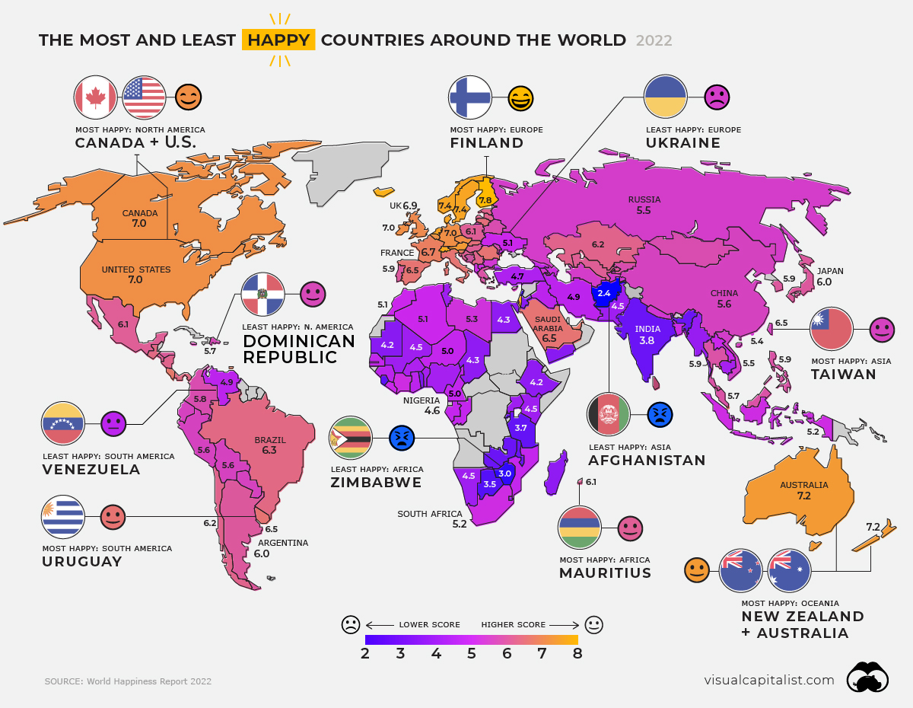

Slide 3
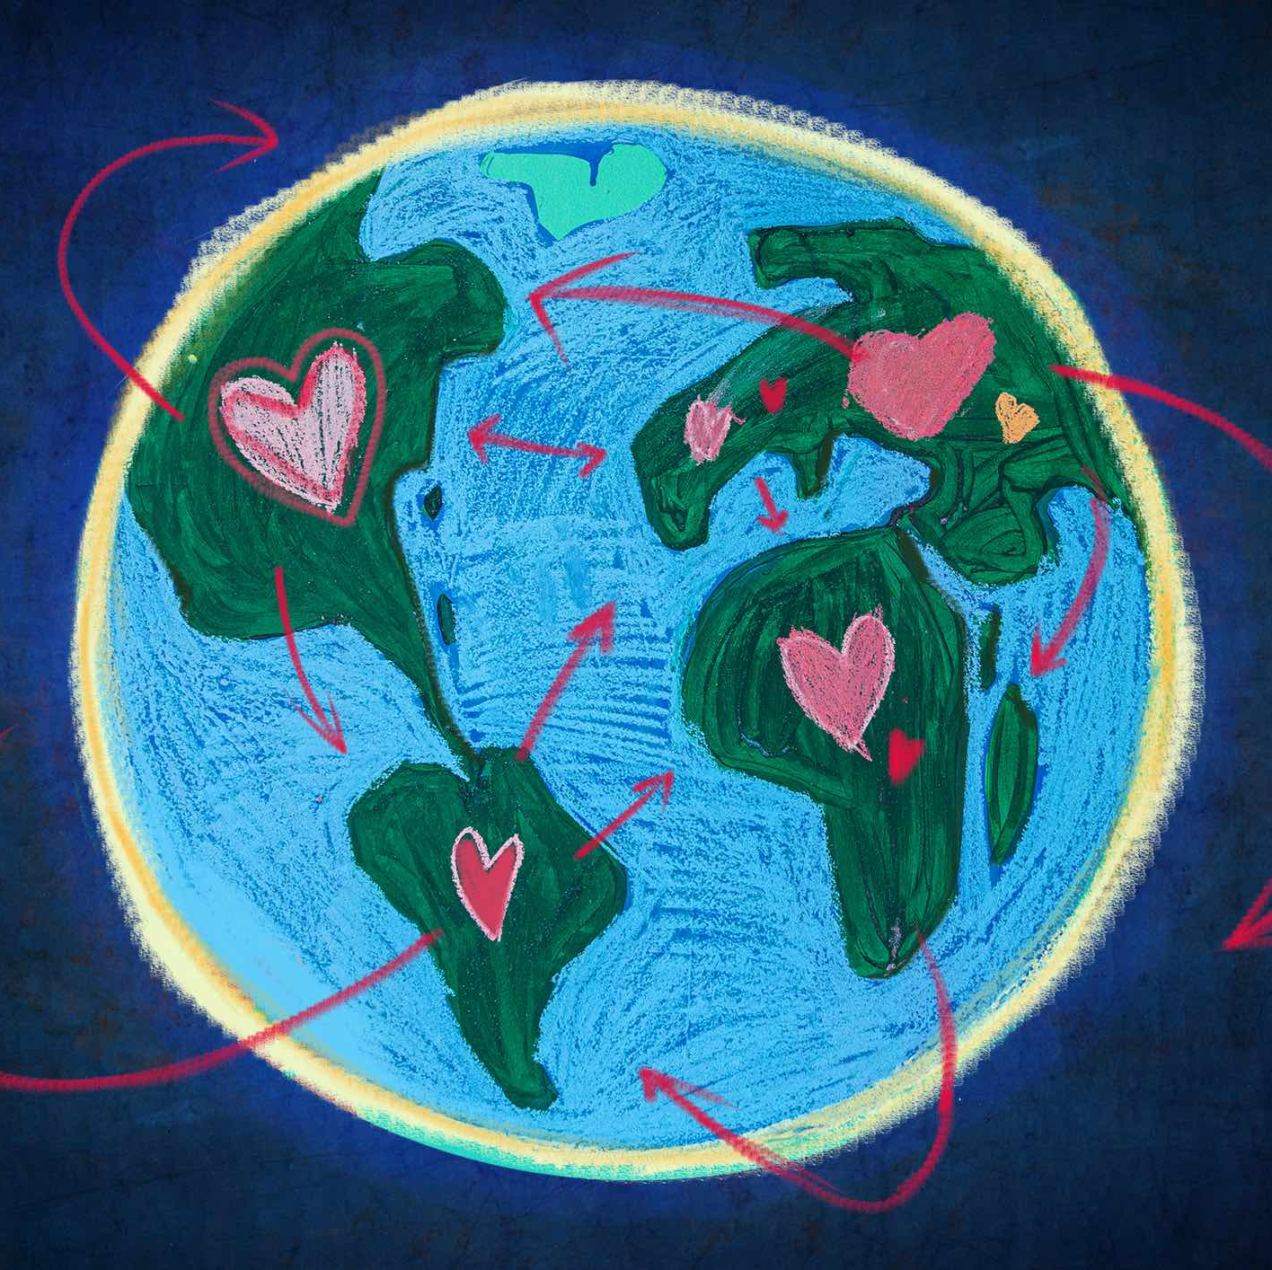
Context
The World Happiness Report is a landmark survey of the state of global happiness . The report continues to gain global recognition as governments, organizations and civil society increasingly use happiness indicators to inform their policy-making decisions.

Slide 4

Leading experts across fields – economics, psychology, survey analysis, national statistics, health, public policy and more – describe how measurements of well-being can be used effectively to assess the progress of nations.

Slide 5
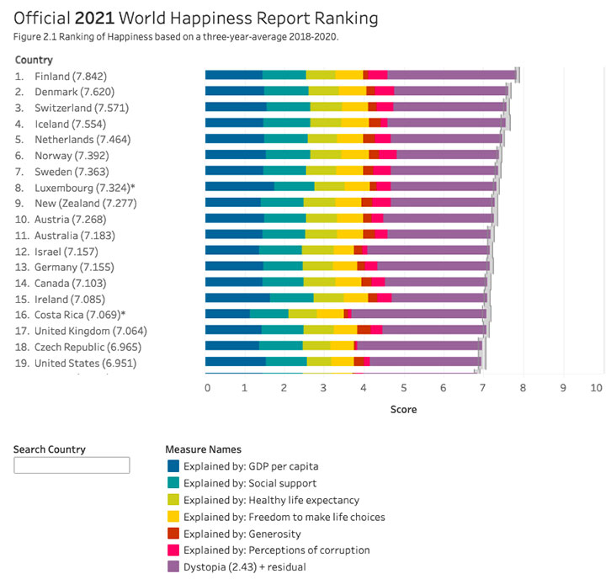
The reports review the state of happiness in the world today and show how the new science of happiness explains personal and national variations in happiness.

Slide 6
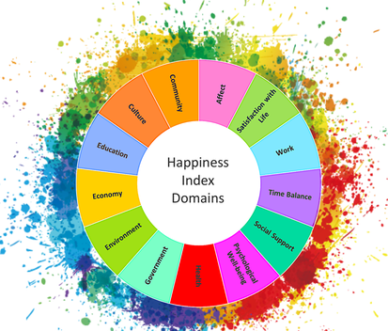
Content
The happiness scores and rankings use data from the Gallup World Poll. The columns following the happiness score estimate the extent to which each of six factors – economic production, social support, life expectancy, freedom, absence of corruption, and generosity – contribute to making life evaluations higher in each country than they are in Dystopia, a hypothetical country that has values equal to the world’s lowest national averages for each of the six factors. They have no impact on the total score reported for each country, but they do explain why some countries rank higher than others.

Slide 7
The dataset typically includes various features that are used to assess happiness, such as economic indicators, social factors, health metrics, and more.
Ladder score: A happiness score given to each country based on survey responses.
Logged GDP per capita: The economic output per person in terms of purchasing power parity.
Social support: The availability of someone to rely on in times of need.
Healthy life expectancy: The average number of years a person can expect to live in good health.
Freedom to make life choices: The degree of personal freedom in life decisions.
Generosity: The willingness to donate or help others.
Perceptions of corruption: The perception of corruption in a country.
These features are typically used to understand the factors that contribute to happiness and well-being on a global scale.

Slide 8
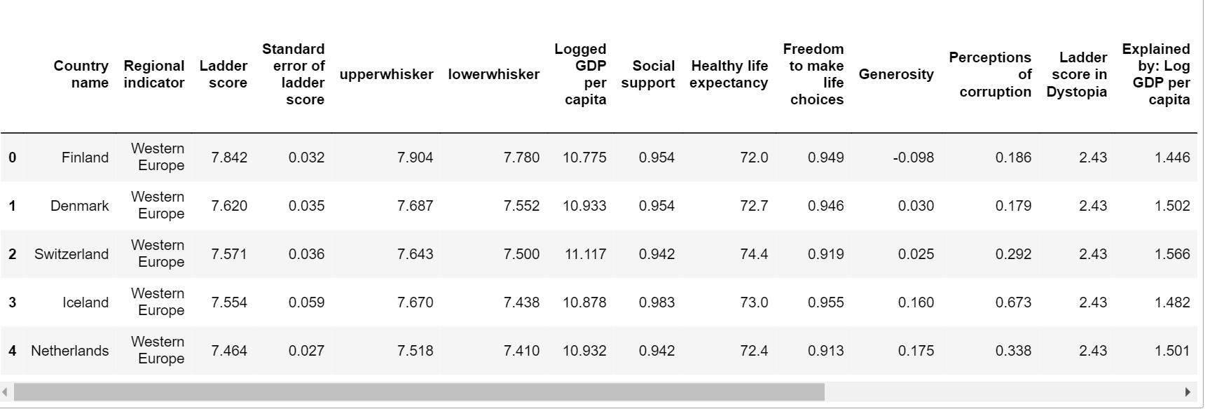

Slide 9
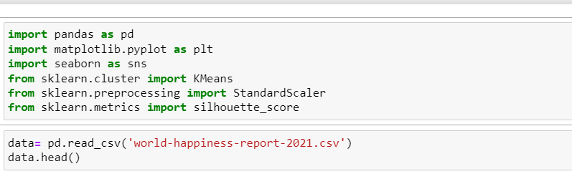
Load and preprocess the data
We started by loading the dataset using the Pandas library. We then preprocessed the data by processing missing values, encoding categorical variables (if any), and scaling numerical features.

Slide 10
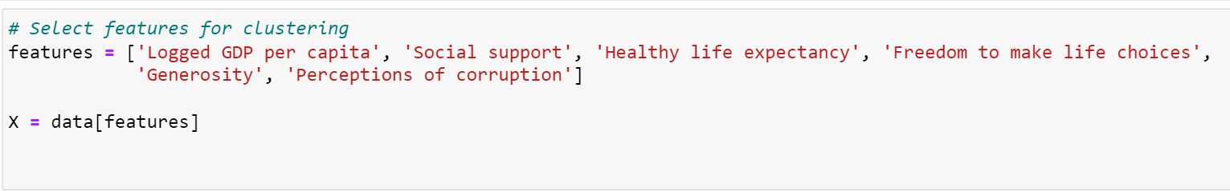
Select features
We selected the relevant features from the dataset we want to use for clustering. For example, we considered variables such as GDP per capita, social support, healthy life expectancy, freedom to make choices in life, generosity and perceptions of corruption.

Slide 11
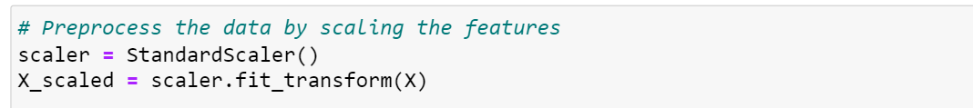
Feature scaling
It is a good practice to scale features before clustering them to ensure they are of the same importance. You can use techniques like MinMaxScaler or StandardScaler from Scikit-learn library, we used StandardScaler.

Slide 12
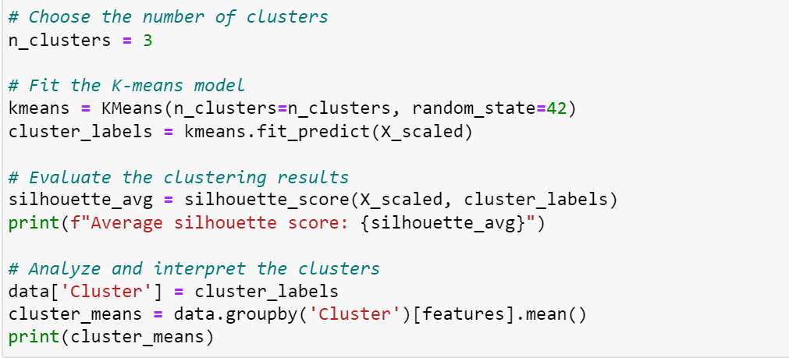
We chose the K-means clustering algorithm

Slide 13
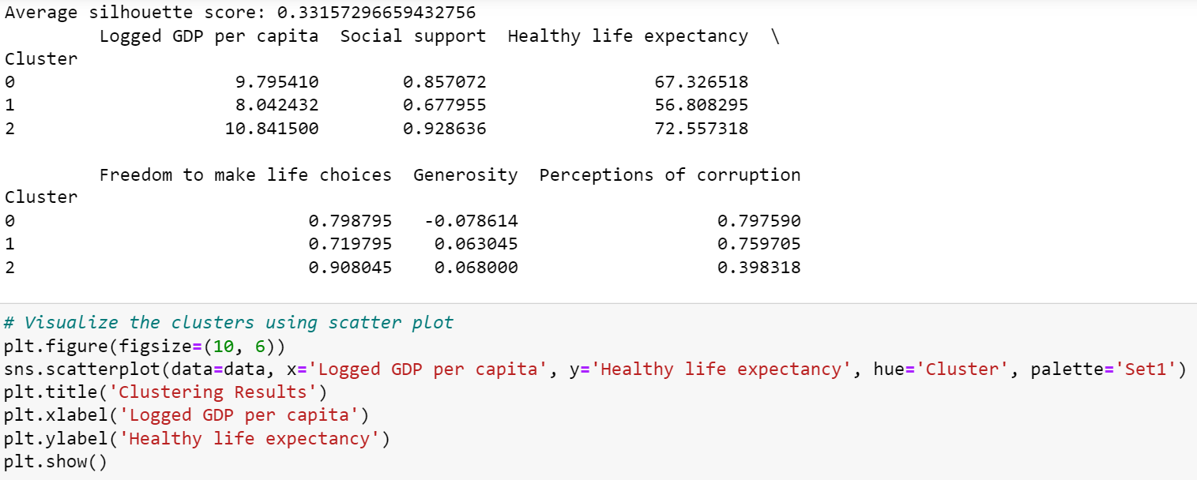

Slide 14
After performing clustering using K-means and obtaining the cluster labels, we add the cluster labels to the original dataset. Then, we use Matplotlib and Seaborn to create a scatter plot. The scatter plot visualizes the clusters by mapping two features, 'GDP per capita' on the x-axis and 'Healthy life expectancy' on the y-axis and coloring the data points based on their cluster labels.

Slide 15
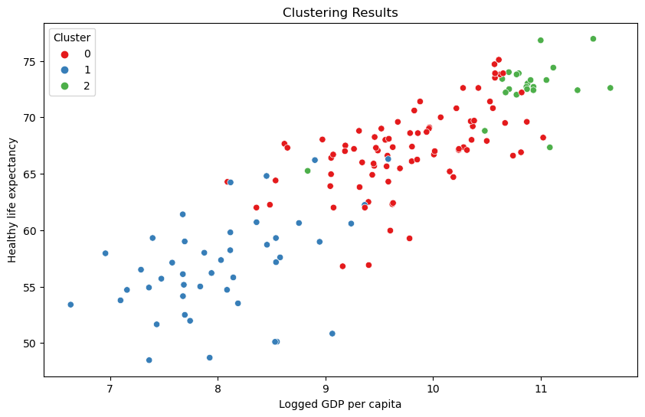

Slide 16
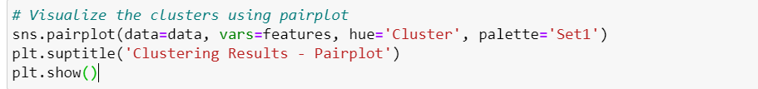
Pairplot
A pairplot can be used to visualize the pairwise relationships between features, colored by the cluster labels.

Slide 17
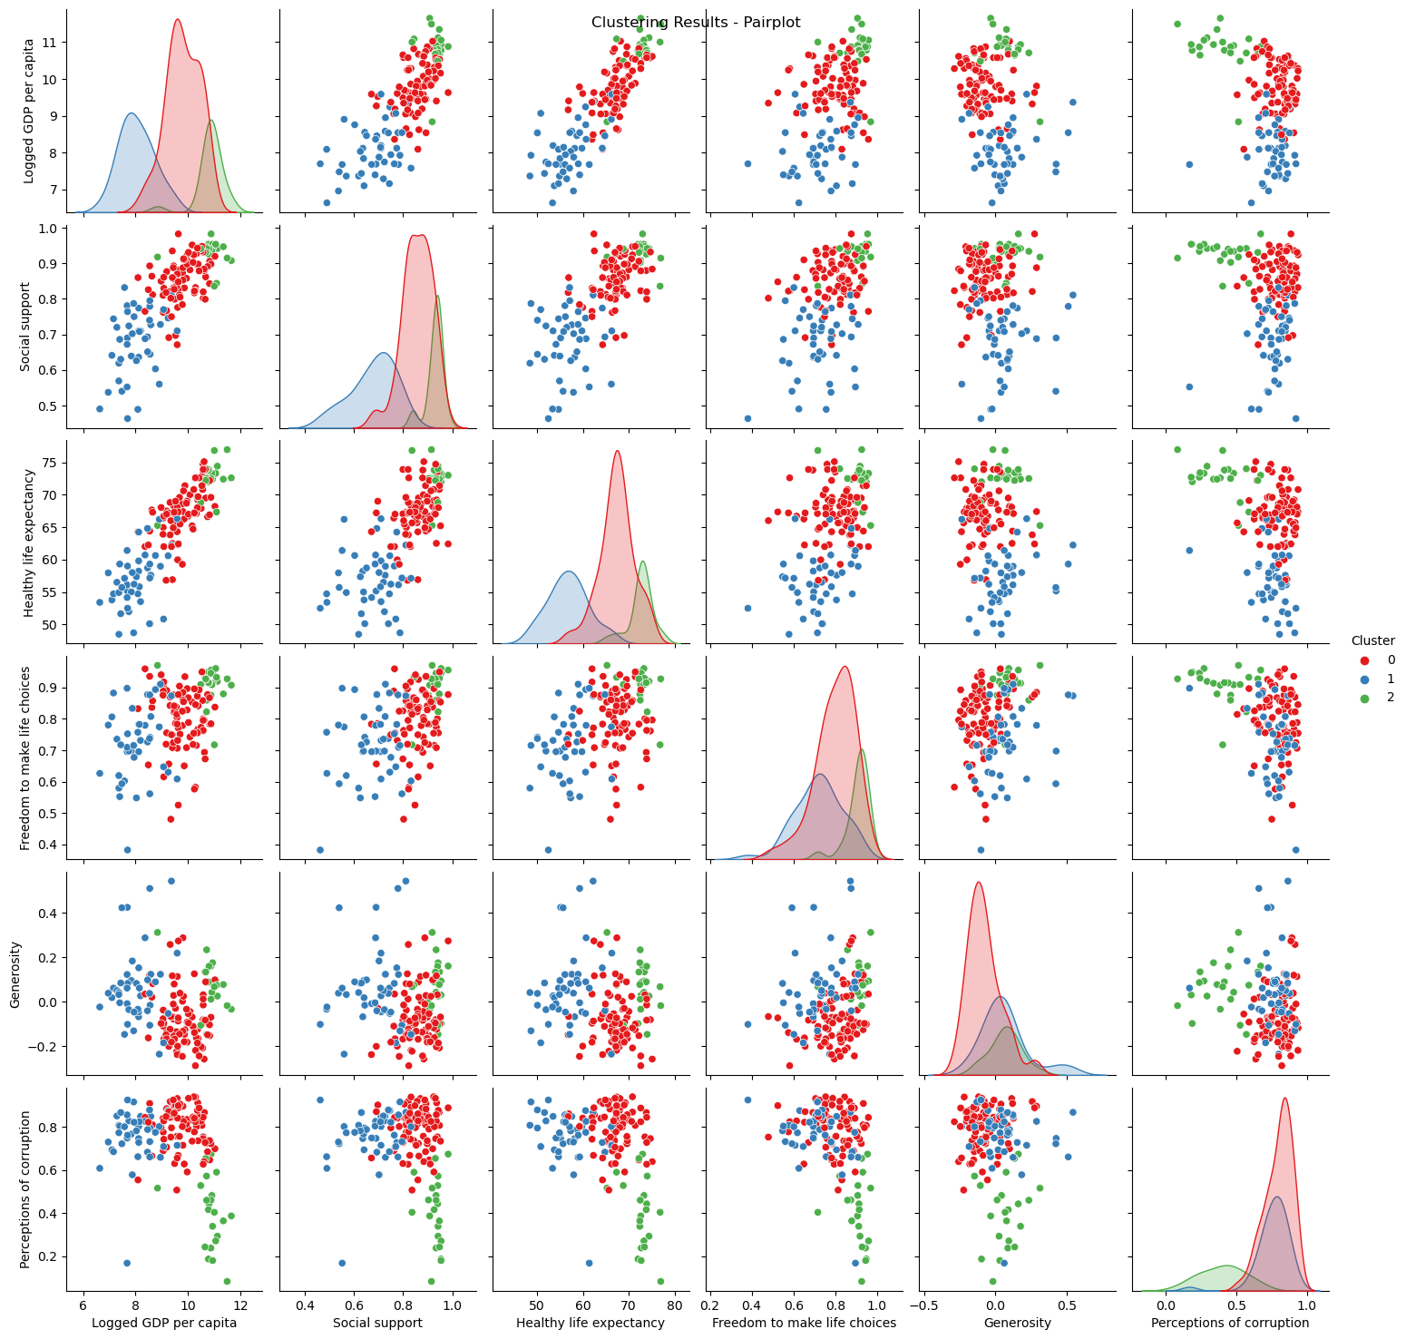

Slide 19
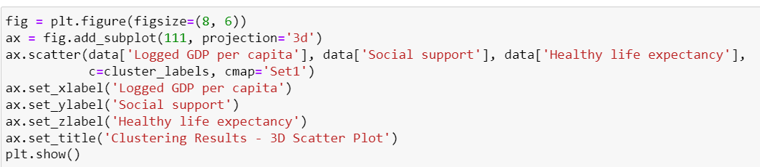
3D Scatter Plot
A 3D scatter plot can be used to visualize three features at a time, where the data points are plotted in a three-dimensional space and colored by cluster labels.

Slide 20
